Slide 1
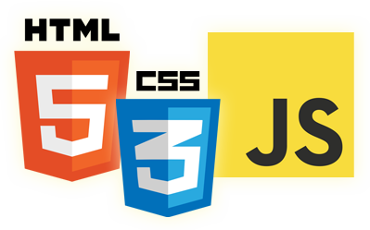


Execution Context & Scope
Eyal Vardi
Microsoft MVP ASP.NET blog: eyalvardi.wordpress.com

Slide 2

Agenda
Hoisting
Execution context
Closures
Variable Pattern
Recursion with functions
Garbage collection

Slide 3
Hoisting
JavaScript program isn’t interpreted line by line, top-down in order, as the program executes.
d = 'ev';
var d;
console.log(d);
var d;
d = 'ev';
console.log(d);
Only the declarations themselves are hoisted, while any assignments or other executable logic are left in place.

Slide 4
Functions First
Both function declarations and variable declarations are hoisted.
Functions are hoisted first , and then variables.
test(); // 1
var test;
function test() {
console.log(1);
}
test = function () {
console.log(2);
};
function test() {
console.log(1);
}
test(); // 1
test = function () {
console.log(2);
};

Slide 5
Declarations vs. Expressions
Function declarations are read and available in an execution context before any code is executed.
Function expressions aren’t complete until the execution reaches that line of code.
Declaration hoisting
Expression, unexpected identifier error.
alert( sum(10, 10) );
function sum(num1, num2) {
return num1 + num2;
}
alert(sum(10, 10));
var sum = function (num1, num2) {
return num1 + num2;
};

Slide 6
Hoisting Internals
try {
printOne();
printTwo();
} catch (e) {
console.log(e.message);
}
// Function Expression
var printOne = function () {
console.log("One");
}
// Function Statement
function printTwo() {
console.log("Two");
}
var printOne = undefined,
printTwo = undefined;
printTwo = function () {
console.log("Two");
}
try {
printOne();
printTwo();
} catch (e) {
console.log(e.message);
}
printOne = function () {
console.log("One");
}

Slide 7
Execution Context & Scope

Slide 8
When Function Created
function add(num1, num2) {
var sum = num1 + num2;
return sum;
}
When the add() function is created, its scope chain is populated with a single variable
object
add.length === 2;
Object.getPrototypeOf(add) === Function.prototype;
Add
[[Scope]]
Scope Chain
0
Global Object
this | Windows
windows | (object)
document | (object)
add | (function)
… | …

Slide 9
When Function Executing
var Total = add( 5 , 10 );
Activation object
this | Windows
arguments | [ 5 , 10 ]
num1 | 5
num2 | 10
sum | undefined
add(5,10) Execution context
Scope chain
Scope Chain
0
1
Global Object
this | Windows
windows | (object)
document | (object)
add | (function)
… | …
Executing the add function triggers the creation of an internal object called an execution context.

Slide 10
Scope Chain
Windows
color
changeColor()
anotherColor
swapColos()
tempColor()
var color = "blue";
function changeColor() {
var anotherColor = "red";
function swapColors(){
var tempColor = anotherColor;
anotherColor = color;
color = tempColor;
// color, anotherColor, and tempColor
// are all accessible here.
}
// color and anotherColor are accessible here,
// but not tempColor.
swapColors();
}
//only color is accessible here
changeColor();

Slide 11
When Function Executing
Each execution context is unique.
multiple calls to the same function result in multiple execution contexts being created.
The execution context is destroyed once the function has been completely executed.

Slide 12
The activation object
Acts as the variable object for this execution and contains entries for:
local variables
named arguments
Arguments collection
this
Pushed to the front of the scope chain.
When the execution context is destroyed, so is the activation object.

Slide 13
Arguments Collection
The arguments object also has a property named callee, which is a pointer to the function that owns the arguments object.
function factorial(num) {
if (num <= 1) { return 1; }
else { return num * factorial(num - 1); }
}
function factorial(num) {
if (num <= 1) { return 1; }
else { return num * arguments.callee(num - 1); }
}

Slide 14
this
Is a reference to the context object that the function is operating on.
The value of this is not determined until the function is called, so its value may not be consistent throughout the code execution.

Slide 15
this Example
var name = "Global";
function Demo1() {
var func1 = function () { return this.name; };
var ObjA = {
name: "A",
getName: function() { return this.name; }
};
var ObjB = {
name: "B",
getName: function () { return this.name; }
};
var a = this;
alert( func1() );
alert( ObjA.getName() );
alert( ObjB.getName() );
}
Demo1();
“Global” , “A” , “B”

Slide 16
Call() Sample
window.color = "red";
var o = { color: "blue" };
function sayColor(){
alert(this.color);
}
sayColor(); //red
sayColor.call(this); //red
sayColor.call(window); //red
sayColor.call(o); //blue

Slide 17
Apply() Sample
function fullName(fName, lName) {
this.fn = fName + " " + lName;
return this;
}
function callfullName (fName, lName) {
this.name = "cfn";
return fullName.apply(this, arguments);
}
function applyfullName (fName, lName) {
this.name = "afn";
return fullName.apply(this, [fName, lName]);
}
alert(new callfullName("E" ,"V")); // {name:'cfn',fn:'E V'}
alert(new applyfullName("E" ,"V"));// {name:'afn',fn:'E V'}

Slide 18
Variable Declaration
Using var automatically added to the most immediate context available.
If a variable is initialized without first being declared, it gets added to the global context automatically.

Slide 19
No Block-Level Scopes
JavaScript’s lack of block-level scopes is a common source of confusion.
if (true) {
var color = "blue";
}
alert(color); //"blue"

Slide 20
No Block-Level Scopes
function outputNumbers(count) {
for (var i = 0; i < count; i++) {
alert(i);
}
alert(i); //count
}
// Solutions
function outputNumbers(count) {
(function () {
for (var i = 0; i < count; i++) {
alert(i);
}
})();
alert(i); //causes an error
}

Slide 21
Scope Chain Augmentation
The catch block & a with statement create scope chain.
function buildUrl() {
var qs = "?debug=true";
with(location){
var url = href + qs;
}
return url;
}
Referring to location.href
function’s context
Location itself is added to
the front of the scope chain
Add to function context

Slide 22
Scope Chain Augmentation
with variable object
href | string
Activation object
this | Windows
arguments | [ 5 , 10 ]
qs | string
url | string
buildUrl() Execution context
Scope chain
Scope Chain
0
1
2
Global Object
this | Windows
windows | (object)
document | (object)
buildUrl | (function)
… | …

Slide 23
Dynamic Scopes
A dynamic scope is one that exists only through execution of code and therefore cannot be determined simply by static analysis.
with statement.
catch clause of a try-catch statement.
a function containing eval().

Slide 24
Dynamic Scopes
function execute(code) {
eval(code);
function subroutine() {
return window;
}
var w = subroutine(); //what value is w?
};
execute("var window = {};")

Slide 25
Closures

Slide 26
Closures
Closures are functions that have access to variables from another function’s scope.
function addEvent() {
var id = "xdi9592";
document.getElementById("save-btn").onclick = function (event) {
saveDocument( id );
};
}
From parent scope

Slide 27
Closure Scope
When the closure is created, its [[Scope]] property is initialized with function activation object and global object.
Activation object
this | Windows
arguments | []
id | “xdi9592”
Scope Chain
0
1
addEvent() Execution context
Scope chain
Closure
[[Scope]]
Scope Chain
0
1
Global Object
this | Windows
windows | (object)
document | (object)
addEvent | (function)
saveDoc | (function)

Slide 28
Closure Execution
Activation object (closure)
this | Windows
arguments | []
event | (object)
Activation object
this | Windows
arguments | []
id | “xdi9592”
Closure execution context
[[Scope]]
Scope Chain
0
1
2
Global Object
this | Windows
windows | (object)
document | (object)
addEvent | (function)
saveDoc | (function)

Slide 29
Closures
Closures are functions that have access to variables from another function’s scope.
function createComparisonFunction(propertyName) {
return function (object1, object2) {
var value1 = object1[propertyName];
var value2 = object2[propertyName];
if (value1 < value2) { return -1; }
else if (value1 > value2) { return 1; }
else { return 0; }
};
}

Slide 30
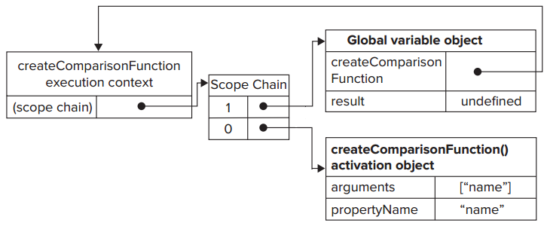
Closures Scope
function createComparisonFunction(propertyName) {}
var compare = createComparisonFunction("name");

Slide 31
Closures Execution Context
function createComparisonFunction(propertyName) {
return function (object1, object2) {...}
}
//create function
var compareNames = createComparisonFunction("name");
//call function
var result = compareNames({ name: "Nicholas" }, { name: "Greg"});
//dereference function - memory can now be reclaimed
compareNames = null;

Slide 32
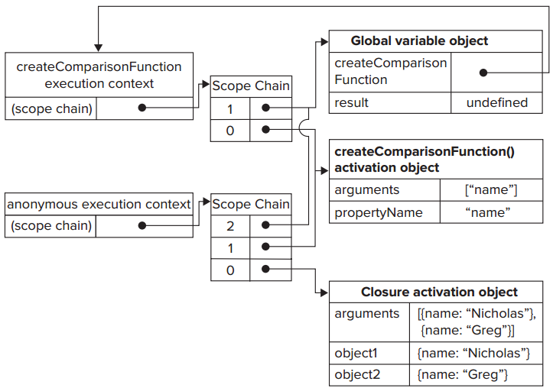
Closures Execution Context
function createComparisonFunction(propertyName) {
return function (object1, object2) {...}
}
//create function
var compareNames = createComparisonFunction("name");
//call function
var result = compareNames({ name: "Nicholas" }, { name: "Greg"});
//dereference function - memory can now be reclaimed
compareNames = null;

Slide 33
Closures and Variables
There is one notable side effect of this scope-chain configuration.
The closure always gets the last value of any variable from the containing function.
function createFunctions() {
var result = new Array();
for (var i = 0; i < 10; i++) {
result[i] = function () { return i; };
}
return result;
}
Every function returns 10, why?

Slide 34
Solution
function createFunctions(){
var result = new Array();
for (var i=0; i < 10; i++){
result[i] = (function(num){
return function(){ return num; };
})(i);
}
return result;
}
Called immediately
Create scope
I is copied into the argument num

Slide 35
The this Object
Using the this object inside closures introduces some complex behaviors.
var name = "The Window";
var object = {
name : "My Object",
getNameFunc : function(){
return function(){ return this.name; };
}
};
alert( object.getNameFunc() () );
// "The Window"
// (in non-strict mode)
object = this
global= this

Slide 36
Solution
var name = "The Window";
var object = {
name : "My Object",
getNameFunc: function () {
var that = this;
return function () { return that.name; };
}
};
alert(object.getNameFunc() () );
// "My Object"

Slide 37
Closures vs. Prototypes
Closure
Prototype
function Point(x, y)
{
var _x = x;
var _y = y;
this.getX = function(){
return _x;
}
this.getY = function(){
return _y;
}
}
function Point(x, y)
{
this._x = x;
this._y = y;
}
Point.prototype =
{
getX: function(){
return this._x;},
getY: function() {
return this._y;}
}

Slide 38
Variable Pattern

Slide 39
Private Variables
JavaScript has no concept of private members.
All object properties are public.
function add(num1, num2) {
var sum = num1 + num2;
return sum;
}

Slide 40
Privileged Method
A privileged method is a public method that has access to private variables and/or private functions.
function MyObject() {
//private variables and functions
var privateVariable = 10;
function privateFunction() { return false; }
//privileged methods
this.publicMethod = function () {
privateVariable++;
return privateFunction();
};
}
Closures with full access to all variables and functions
defined inside the constructor’s scope.

Slide 41
Static Private Variables
Privileged methods can also be created by using a private scope to define the private variables or functions.
(function(){
//private variables and functions
var privateVariable = 10;
function privateFunction(){ return false; }
//constructor
MyObject = function(){ };
//public and privileged methods
MyObject.prototype.publicMethod = function () {
privateVariable++;
return privateFunction();
};
})();
global variable
The privileged method, being a closure, always holds a reference to the containing scope.

Slide 42
Static Private Variables
(function(){
var name = "";
Person = function(value){ name = value; };
Person.prototype.getName = function(){ return name; };
Person.prototype.setName = function (value){ name = value; };
})();
var person1 = new Person("Nicholas");
alert(person1.getName()); // ”Nicholas”
person1.setName("Greg");
alert(person1.getName()); // ”Greg”
var person2 = new Person("Michael");
alert(person1.getName()); // ”Michael”
alert(person2.getName()); // ”Michael”

Slide 43
The Module Pattern
The module pattern augments the basic singleton to allow for private variables and privileged methods.
var singleton = (function(){
//private variables and functions
var privateVariable = 10;
function privateFunction(){ return false; }
//privileged/public methods and properties
return {
publicProperty: true,
publicMethod : function(){
privateVariable++;
return privateFunction();
}
};
})();

Slide 44
Singleton Initialization
var application = function(){
//private variables and functions
var components = new Array();
//initialization
components.push(new BaseComponent());
//public interface
return {
getComponentCount : function(){ return components.length; },
registerComponent : function(component){
if (typeof component == "object"){
components.push(component);
}
}
};
}();

Slide 45
Recursion with Functions

Slide 46
Recursion
A recursive function typically is formed when a function calls itself by name.
function factorial(num) {
if (num <= 1) {
return 1;
} else {
return num * factorial(num - 1);
}
}

Slide 47
Recursion Problem
var anotherFactorial = factorial;
factorial = null;
alert( anotherFactorial(4) ); //error!
function factorial(num) {
if (num <= 1) {
return 1;
} else {
return num * arguments.callee(num - 1);
}
}
The value of arguments.callee is not accessible to a script running in strict mode and will cause an error when attempts are made to read it.

Slide 48
Recursion Solution
The name f remains the same even if the function is assigned to another variable, so the recursive call will always execute correctly.
var factorial = (function f( num ) {
if ( num <= 1 ){
return 1;
} else {
return num * f(num - 1);
}
});

Slide 49
Breaking Recursion
function processArray(items, process, callback) {
var todo = items.concat(); //create a clone of the original
setTimeout( function () {
process(todo.shift());
if (todo.length > 0) {
setTimeout( arguments.callee, 25 );
} else {
callback( items );
}
}, 25);
}

Slide 50
Garbage Collection
Two strategies have traditionally been used in browsers:
Mark-and-Sweep
Reference Counting
When data is no longer necessary, it’s best to set the value to null, freeing up the reference (dereferencing the value).

Slide 51

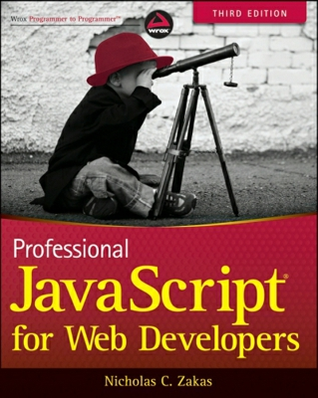
Resources
Professional JavaScript for Web Developers – book
High Performance JavaScript - book
Good links:
http://eyalvardi.wordpress.com/resources/html-5-course-resourses/javascript/

Slide 52
Thanks
eyalvardi.wordpress.com
Eyal Vardi
Microsoft MVP ASP.NET blog: eyalvardi.wordpress.com

